Slide 1

Project 2 : Cellular response to drug perturbations
Ann- Sophie Kröll, Jana Braunger & Anna Münch
Supervisor: Nicolàs Palacio-Escat and Javier Perales-Patón
Tutor: Julia Rühle - 15.05.2019

Slide 2

NCI Transcriptional Pharmacodynamics Workbench
15 drugs → Erlotinib
2 concentrations ( c_{max} , GI₅₀)
12,704 genes
NCI-60-Cell line
Comparison untreated and treated transcriptional expression

Slide 3
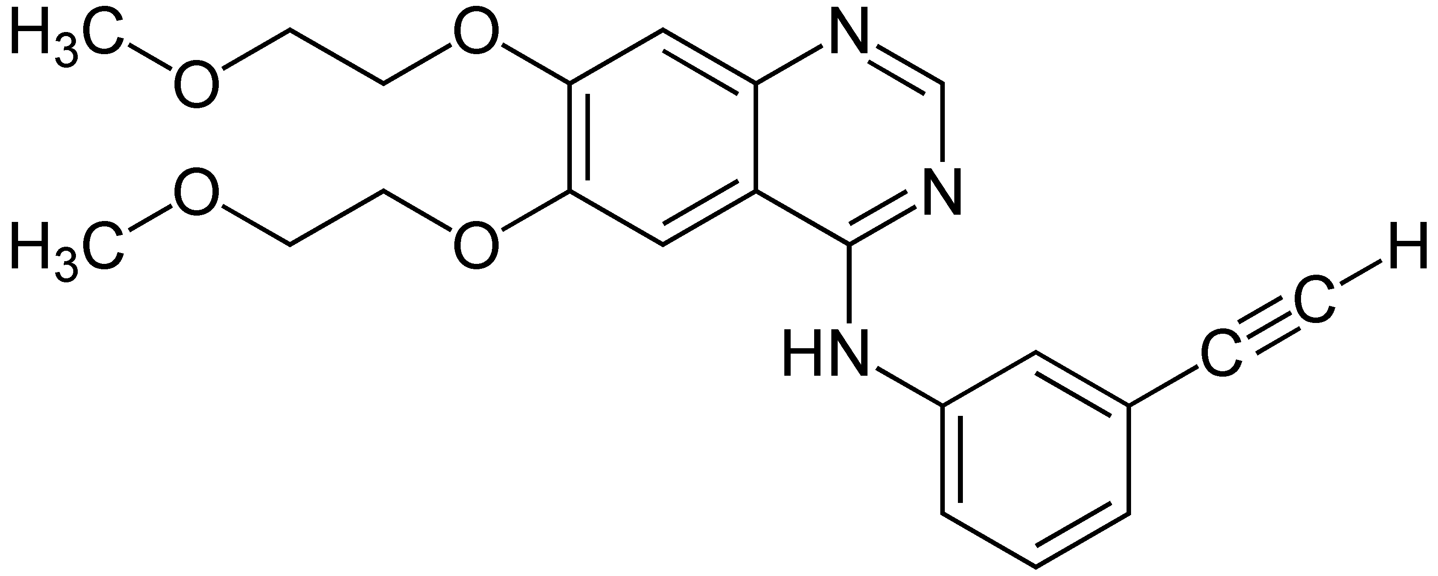

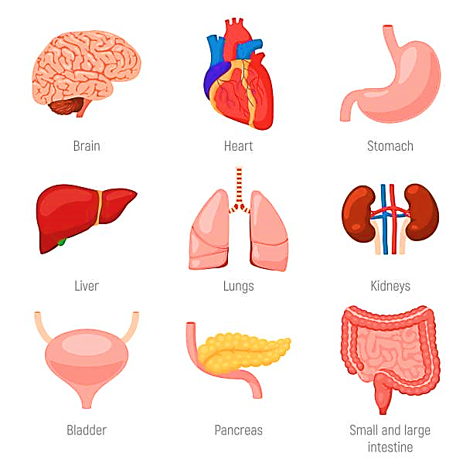
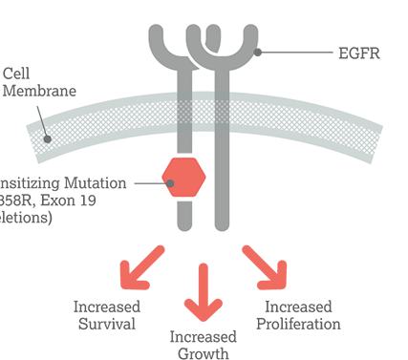
Erlotinib
Kinase inhibitor (EGFR, Her 1 receptor)

Slide 4
Broad Analysis
Influenced Genes
Influenced
Cell lines
Correlation with cell proliferation
Influenced Pathways
Sieht doof aus … daher würde ich die anderen Folien nehmen, wo die betreffende Ecke raus kommt.
Da ich den text nicht kopfüber schreiben kann….

Slide 5
Broad Analysis
Influenced Genes
Influenced
Cell lines
Correlation with cell proliferation
Influenced Pathways

Slide 6
Broad Analysis
Influenced Genes
Influenced
Cell lines
Correlation with cell proliferation
Influenced Pathways

Slide 7
Broad Analysis
Influenced Genes
Influenced
Cell lines
Correlation with cell proliferation
Influenced Pathways

Slide 8
Broad Analysis
Influenced Genes
Influenced
Cell lines
Correlation with cell proliferation
Influenced Pathways

Slide 9
Broad Analysis
Influenced Genes
Influenced
Cell lines
Correlation with cell proliferation
Influenced Pathways

Slide 10

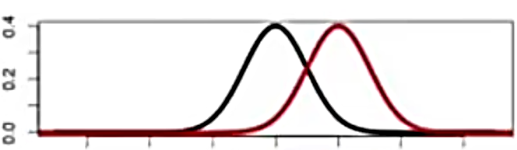
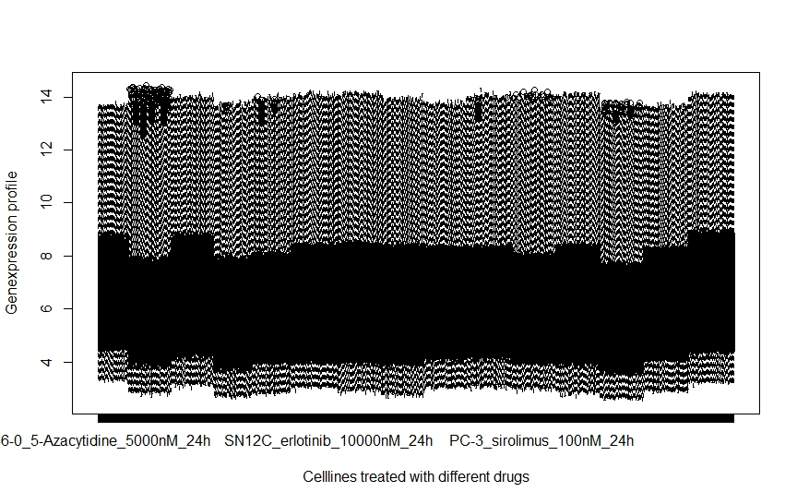
1. Milestone - Broad analysis
Expression profiles: density plots and box plots
treated vs. untreated
Down- and upregulated genes separately
PCA: cell line treated with all drugs
Clusters
Select biomarkers for each cell line

Slide 11


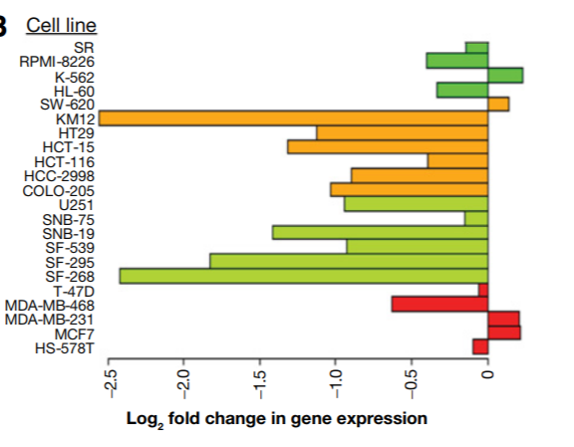
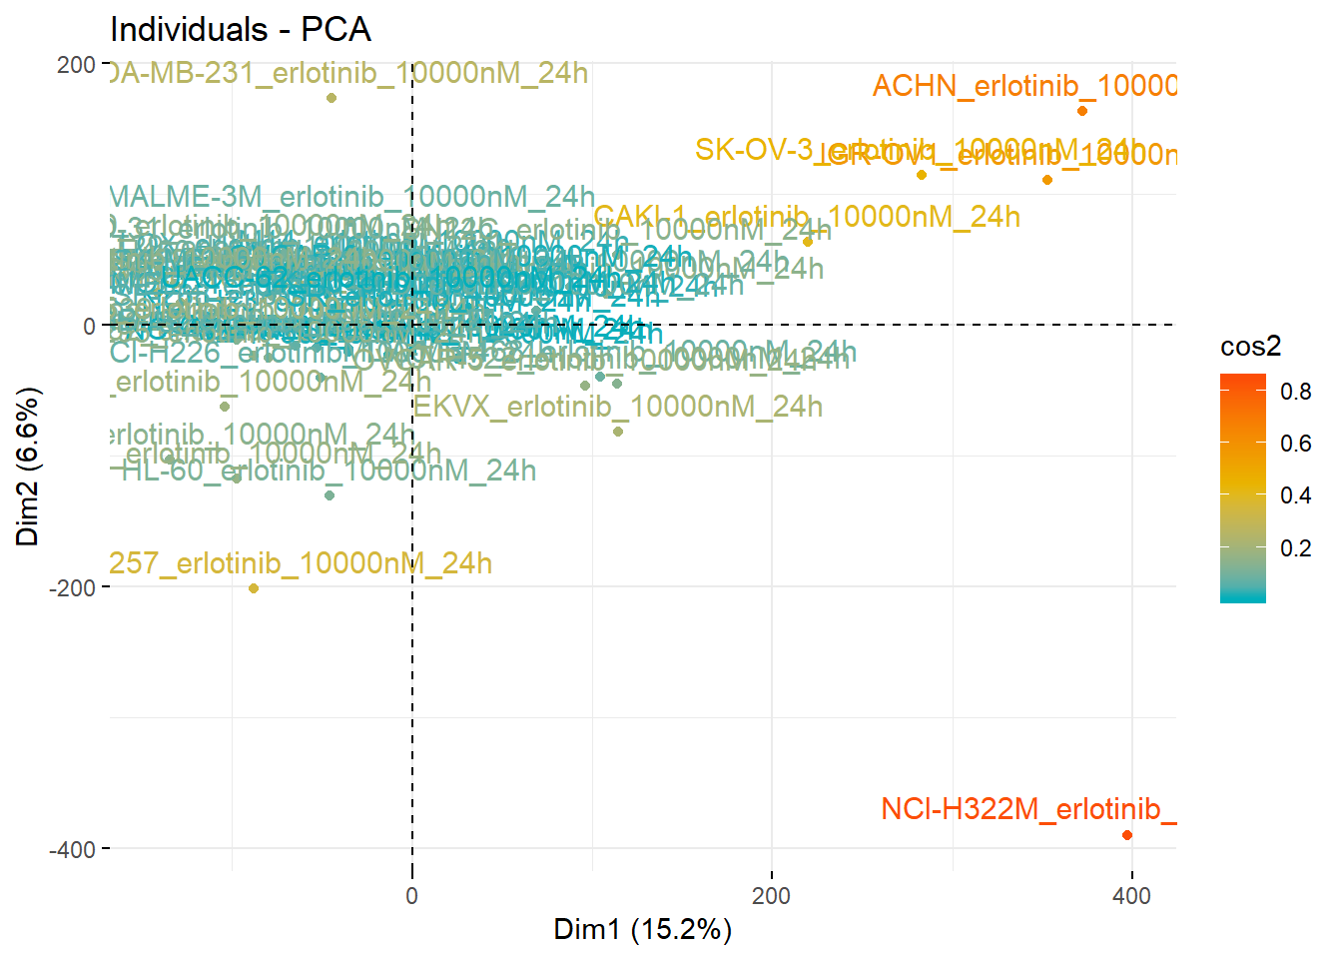
2. Milestone – Which genes and cell lines exposed the most change in regulation after Erlotinib treatment?
Cell lines
Via PCA
Greatest variance in FC
Notes:
Differences between cell lines are more relevant to expression than drug treatment in PCA -> Treated (logarithmic data) - untreated (logarithmic data)
three most regulated genes
for 15 cell lines and colour the cancer type

Slide 12
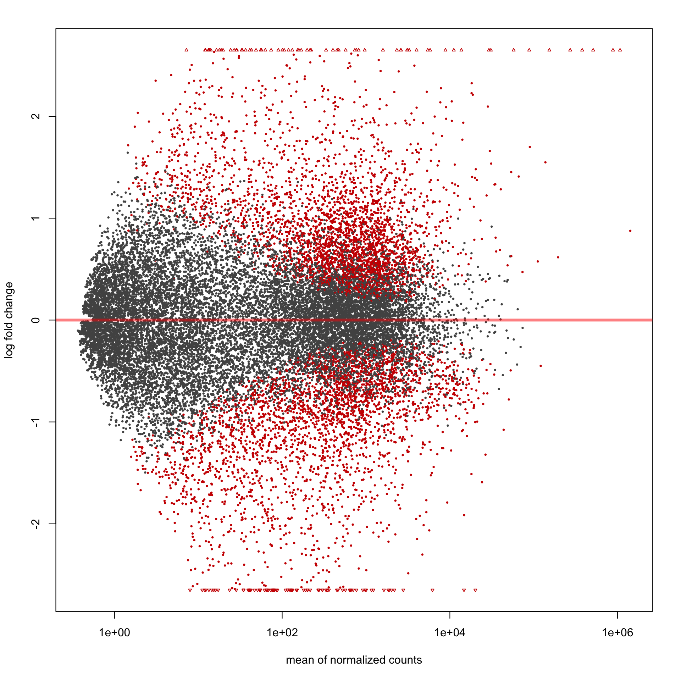
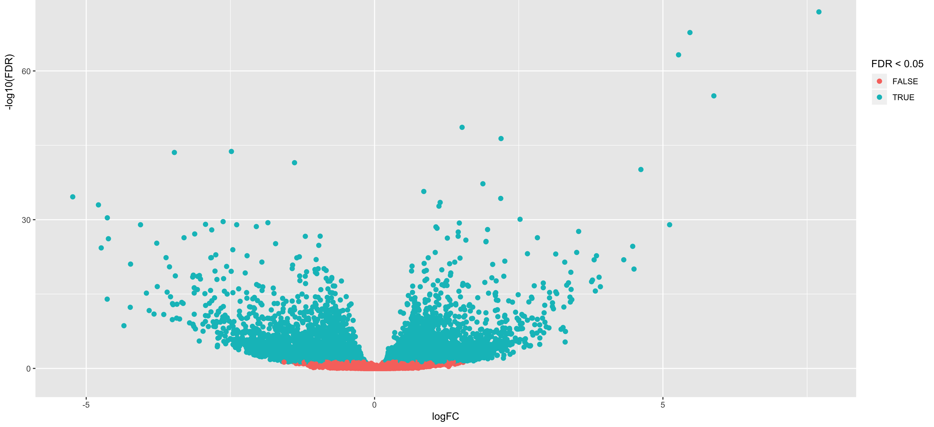
2. Milestone – Which genes and cell lines exposed the most change in regulation after Erlotinib treatment?
Genes
MA plot (of one cell line)
Volcano plot
(FC against FDR – t-test)
Single gene response plot
Notes:
Differences between cell lines are more relevant to expression than drug treatment in PCA -> Treated (logarithmic data) - untreated (logarithmic data)
three most regulated genes
for 15 cell lines and colour the cancer type

Slide 13

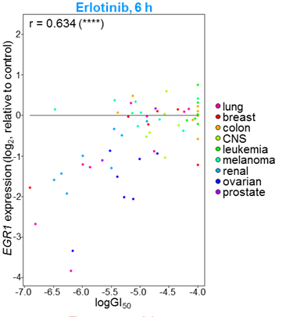
3. Milestone – Does the fold change correlate with cell growth inhibition?
median of gene expression changes
Paired t-test
Wilcoxon signed rank test
Pearson Correlation with FC and GI50
→ linear regression
→ compare with 6h timepoint (Fig. S2)

Slide 14
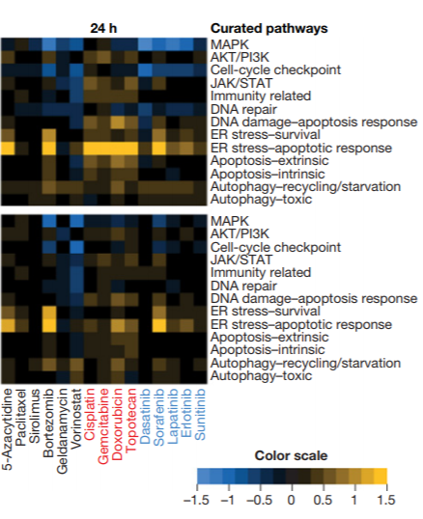
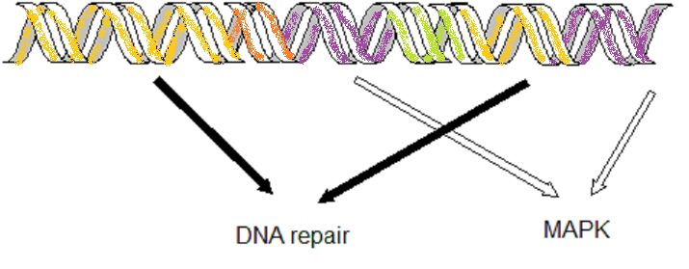
4. Milestone – Which cellular pathway’s are influenced by Erlotinib?
PROGENy or NCI
→ affected cellular pathways
Heatmap: cell-lines vs. pathways
(median of FC of relevant genes)
Comparison with other drugs
15 Cell lines

Slide 15

Timeline
12 Weeks
with 2 weeks for each mile stone
4 weeks at the end to interpret the data and come up with future investigations, which could provide novel insight

